Slide 1




logic.js
Tracking-Images
Augmentations
Libraries
Tracking-Images
Augmentations
Positionen
Orientation
ID's
Plattform unabhängig
→ WebApp
→ MobileApp
→ DesktopApp

Slide 2

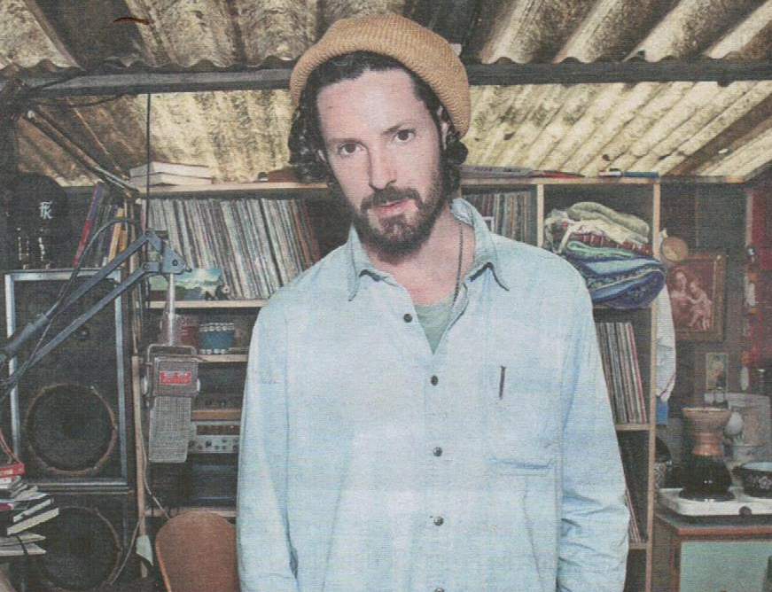

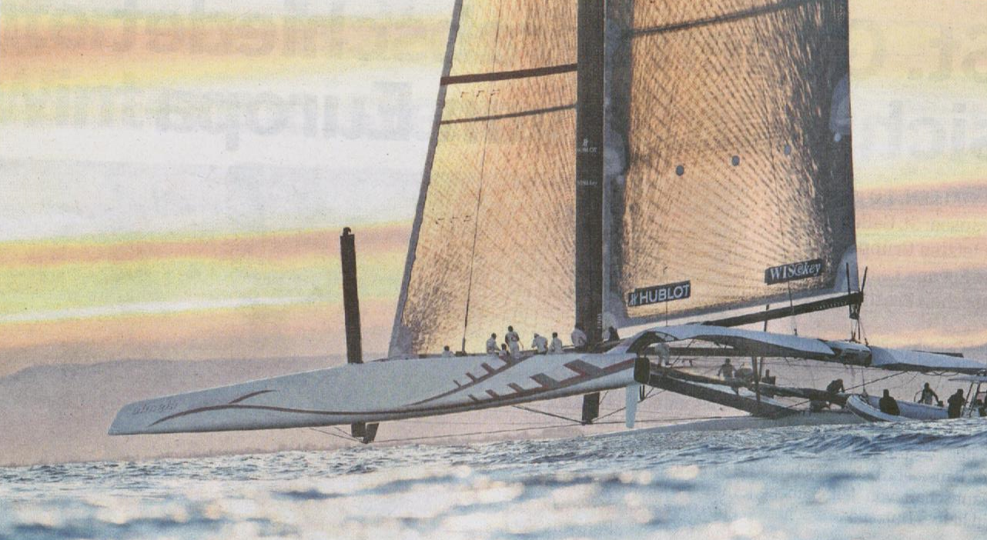
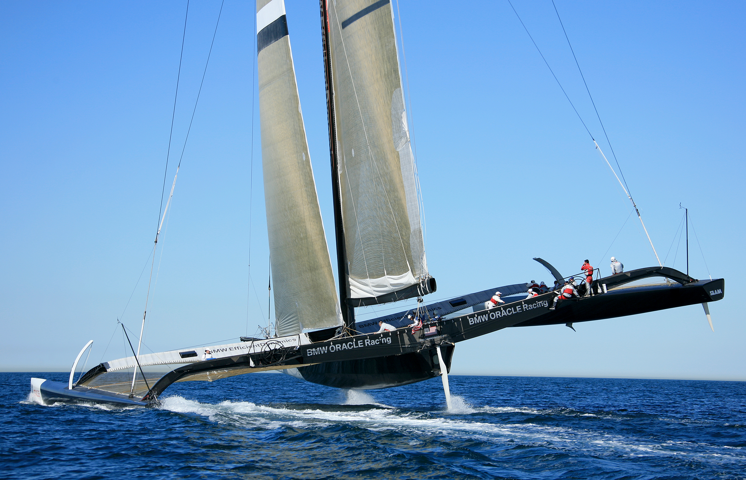

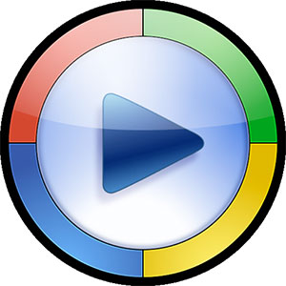
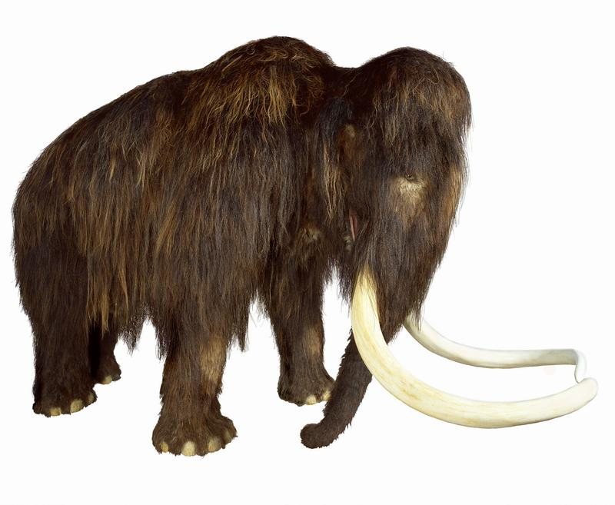


20Minuten vom 13.12.2013
Tracking Image
Augmentation
Video
3D Objekt
Slideshow

